Slide 1
Indexing Techniques

Slide 2

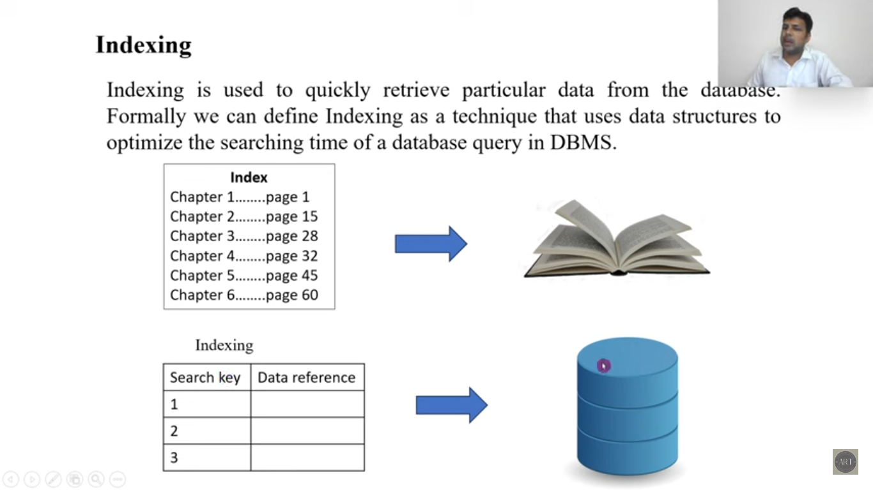

Slide 3
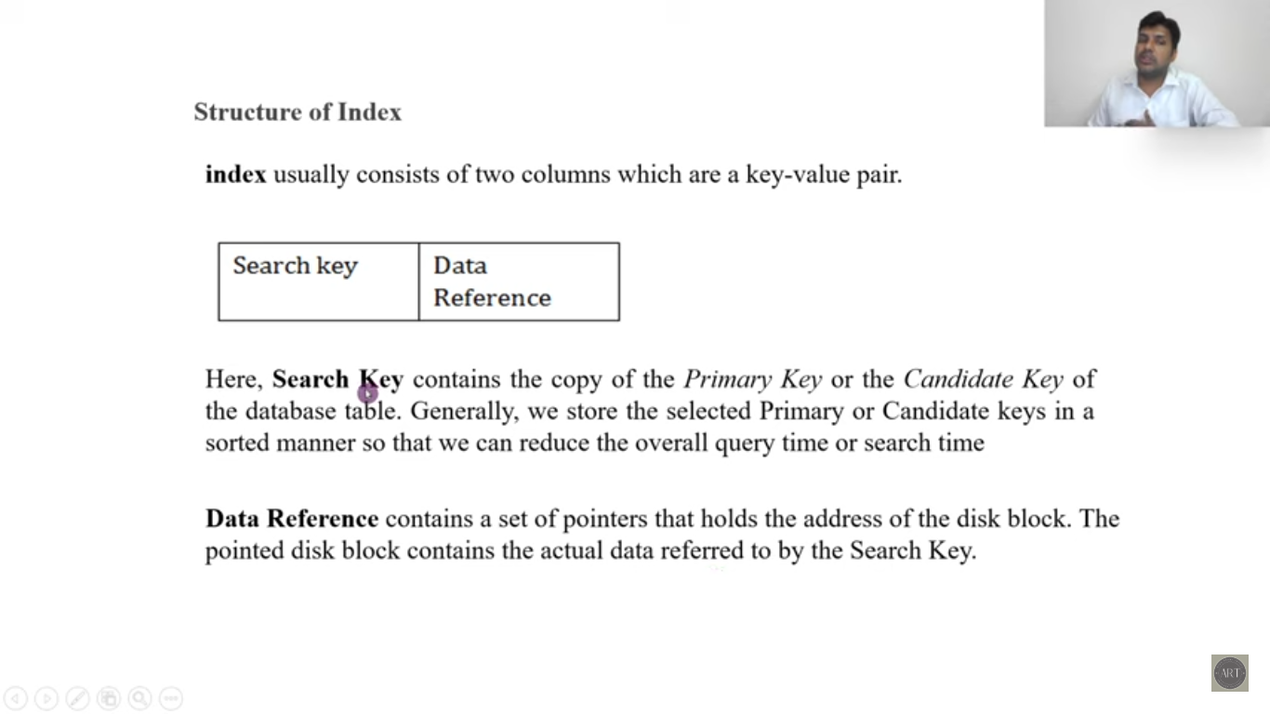

Slide 4
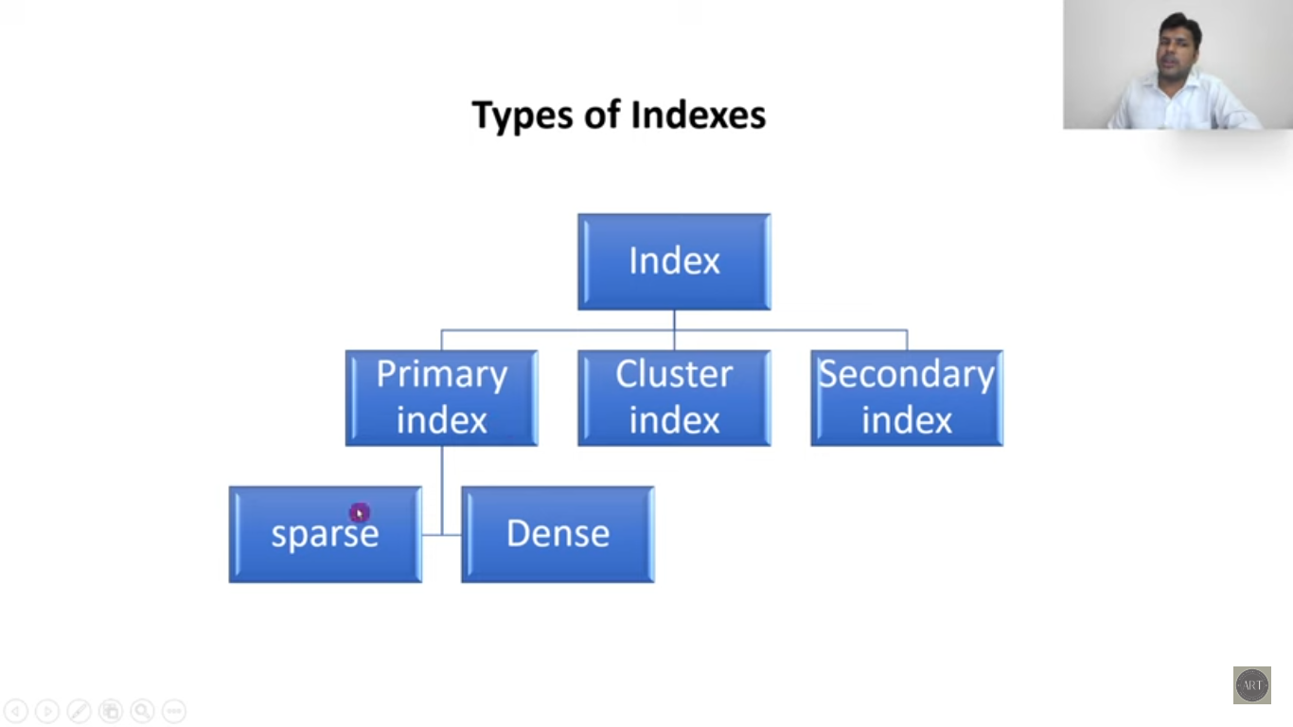

Slide 5
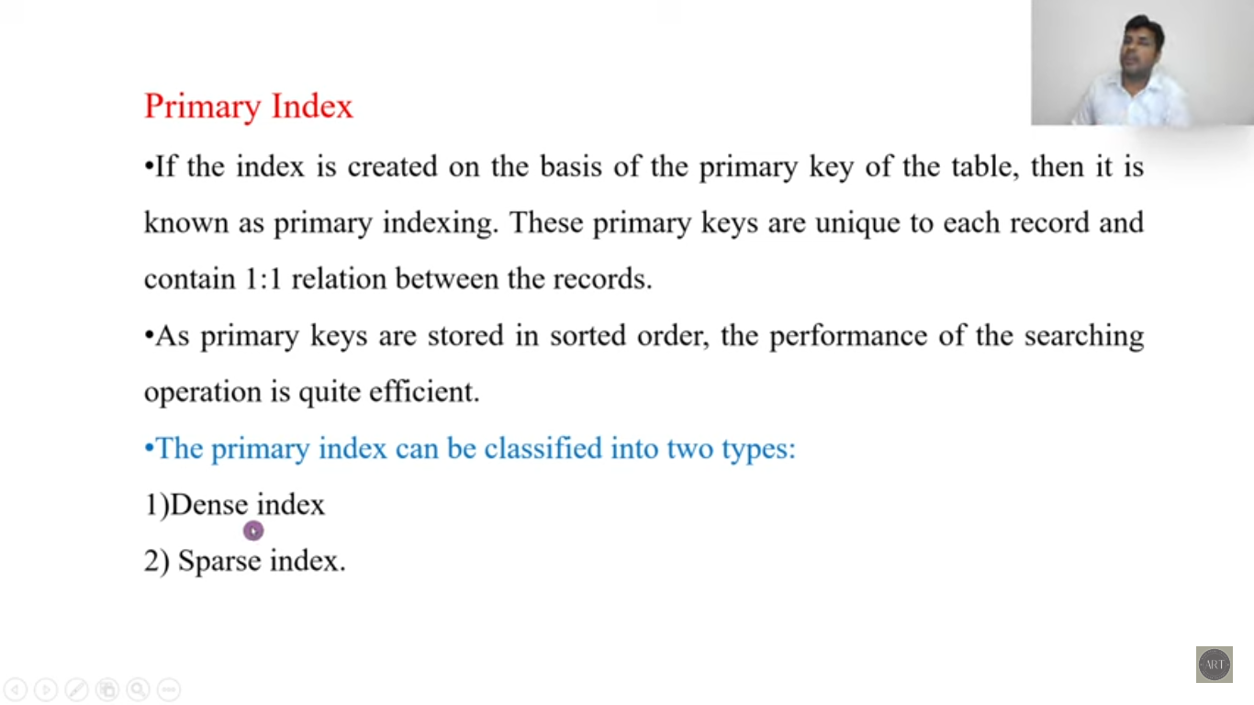

Slide 6
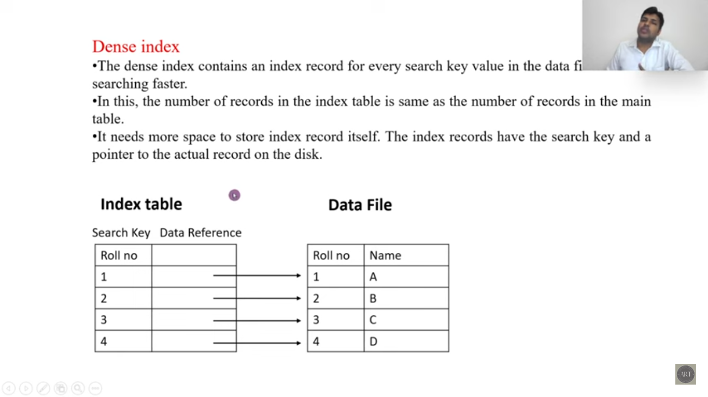

Slide 7
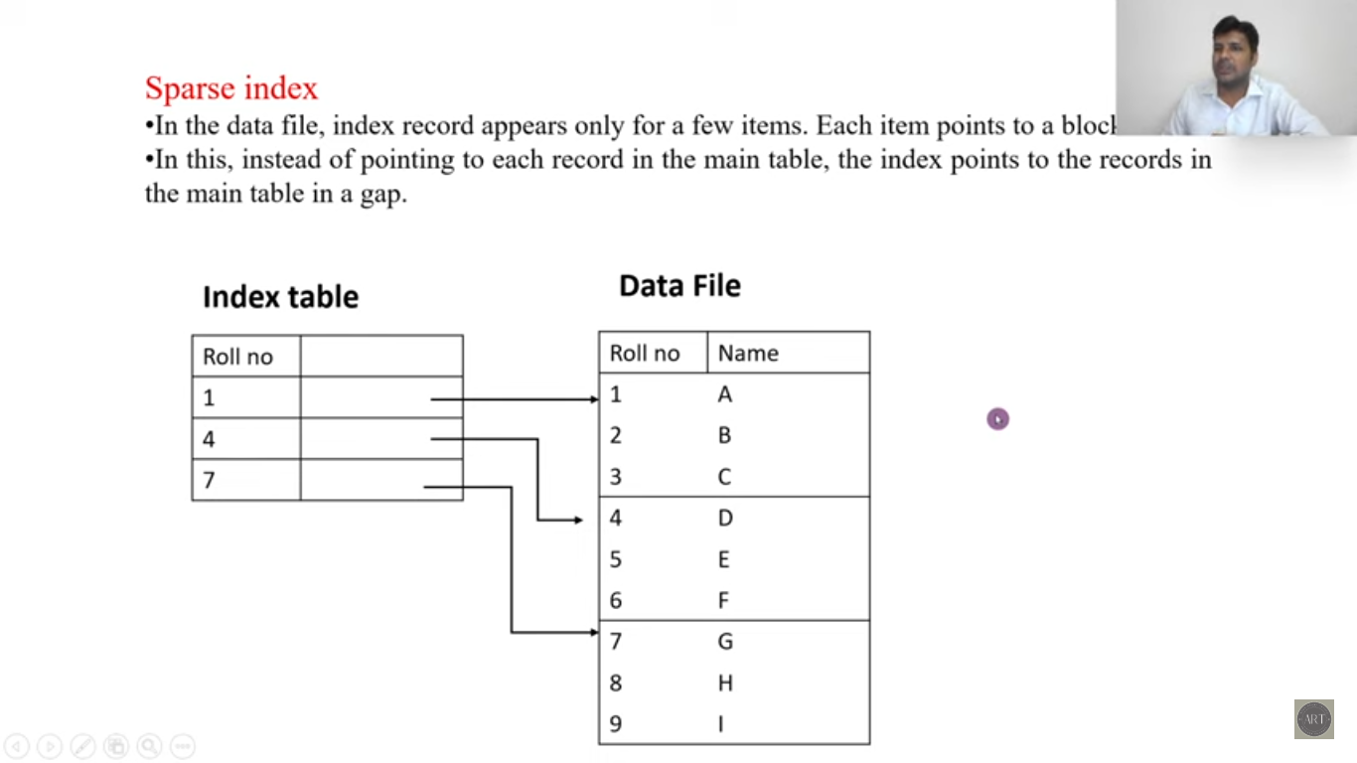

Slide 8
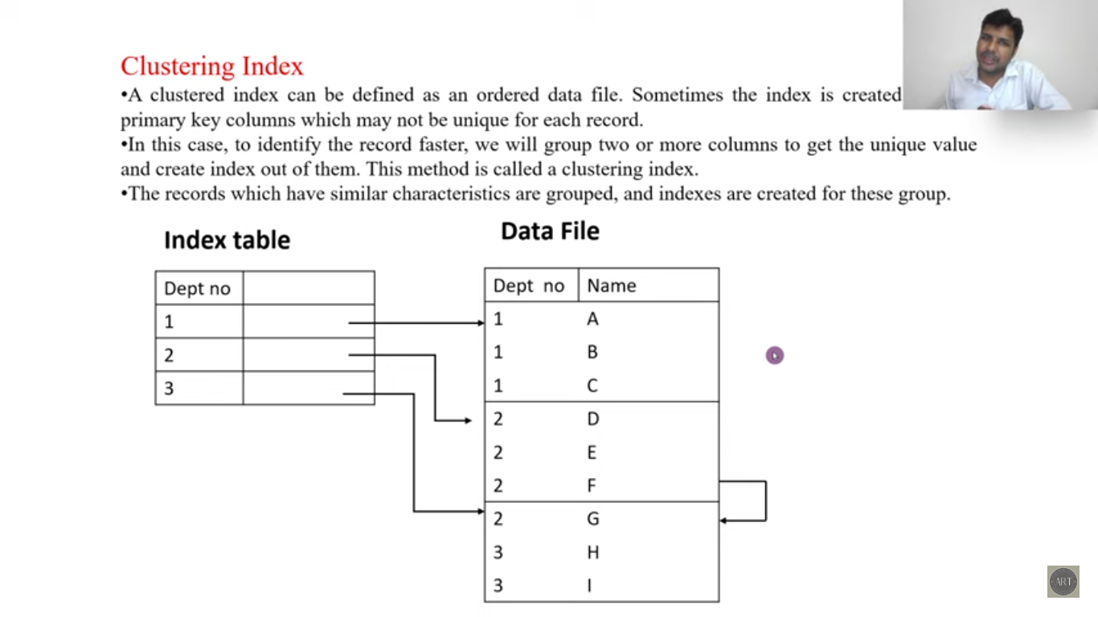

Slide 9
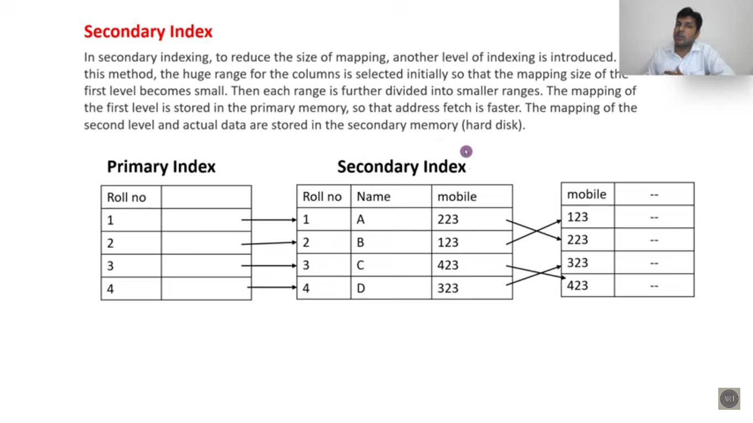

Slide 10
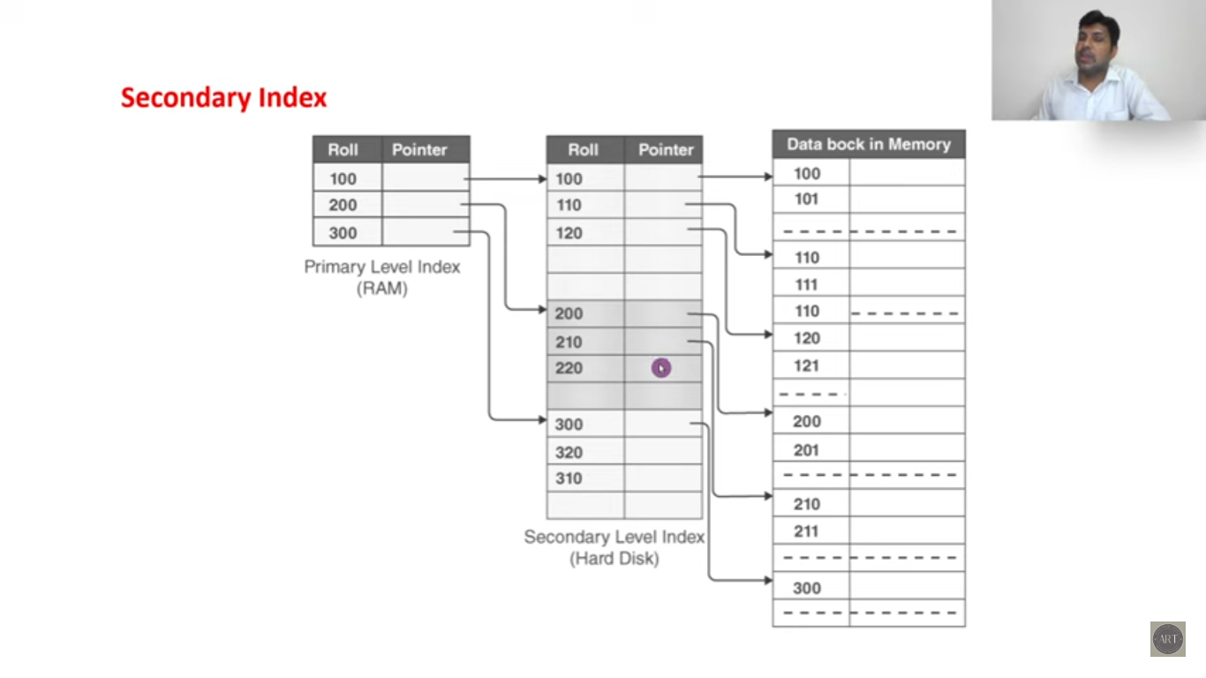

Slide 11
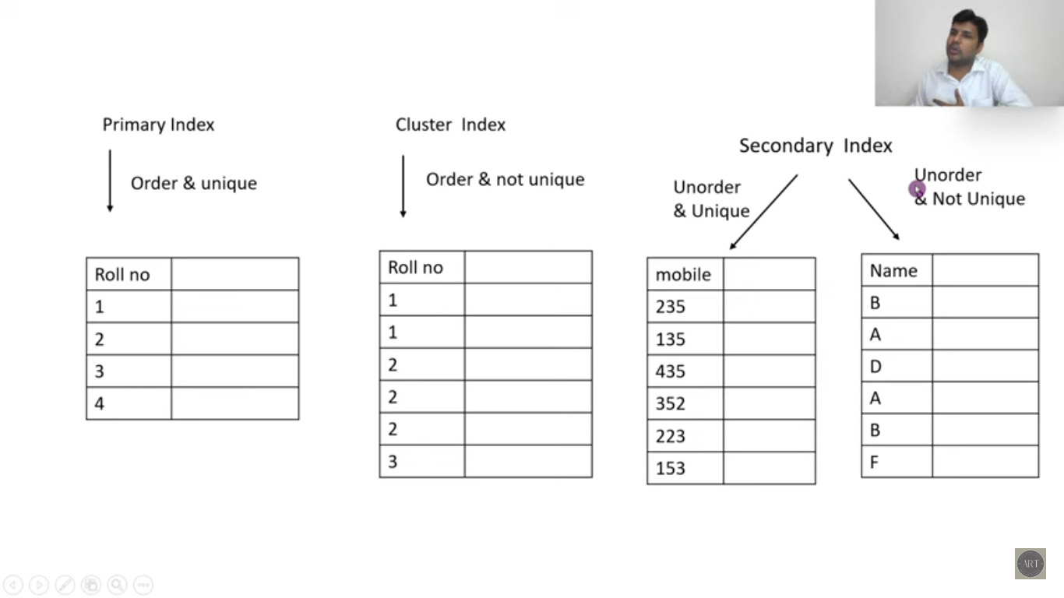

Slide 12
B+ Trees
A B+ Tree is a type of data structure used in computer science to store and organize data.
It is a special kind of tree where all the values (data) are stored in the leaf nodes, and the internal nodes are used only for indexing (like a table of contents).
This structure helps in quickly finding, inserting, and deleting data.
In a B Plus Tree, the leaf nodes are linked together like a linked list, which makes it easy to find a range of values quickly.

Slide 13
Properties of B+ Tree
Balanced Tree Structure: B+ Trees are balanced, meaning all leaf nodes are at the same level.
Leaf Nodes Store All Values: All actual data values are stored in the leaf nodes.
Internal Nodes for Indexing: Internal nodes contain only keys and pointers to child nodes.
Linked List of Leaf Nodes: Leaf nodes are linked together in a linked list.
Order of the Tree: The order (m) of a B+ Tree defines the maximum number of children each internal node can have.
Minimum Degree: The minimum degree (t) of a B+ Tree is defined as ⌈m/2⌉.
Efficient Disk Read/Write: B+ Trees are designed to minimize disk I/O operations.

Slide 14
Nodes in B+ Tree
In a B+ Tree, nodes are of two main types: internal nodes and leaf nodes.
Internal Nodes
Internal nodes are used for indexing and routing purposes within the tree. They do not store actual data values but rather keys that help in navigating the tree.
Leaf Nodes
Leaf nodes store the actual data values. All the data in a B+ Tree is contained within the leaf nodes.

Slide 15
Order of B+ Tree
The order of a B+ Tree, often denoted as m, is a fundamental property that determines the tree's structure and balance. The order of a B+ Tree specifies the maximum number of children that any node in the tree can have. Here’s a detailed explanation of what the order of a B+ Tree means and its implications:
Order m:
The order of a B+ Tree is the maximum number of children that any internal node can have.
For a B+ Tree of order m:
Each internal node can have at most m children.
Each internal node (except the root) must have at least (m/2) children.
Each internal node must have between (m/2) - 1 and m - 1 keys.
Each leaf node must have between (m/2) and m values.

Slide 16
Operations on B+ Trees
B+ Trees support various operations such as insertion, deletion, and searching. These operations ensure that the tree remains balanced and efficient for data retrieval and modification.
1. Insertion
Algorithm:
Start from the root and find the appropriate leaf node where the key should be inserted.
Insert the key in the leaf node in sorted order.
Split the Node (if necessary):
If the leaf node has more than m−1 keys after insertion, split the node into two.
Promote the middle key to the parent node.
If the parent node also overflows, repeat the splitting process up to the root.
Ensure that leaf nodes are linked correctly after any split.

Slide 17
Operations on B+ Trees
2. Deletion
Algorithm:
Start from the root and find the leaf node containing the key.
Remove the key from the leaf node.
Merge or Redistribute Nodes (if necessary):
If the leaf node has fewer than ⌈m/2⌉ keys after deletion, merge or redistribute nodes.
If merging, remove the corresponding key from the parent and merge nodes.
If the parent node underflows, repeat the process up to the root.

